Slide 1

Wireless Power Transfer
C1C Henry
C1C Hermanson
C1C Pak
C1C Singh
1

Slide 2
Overview
Technical Discussion/Attack Vector Review - NSTR
Motivation - NSTR
Problem Statement - NSTR
Key Sprint Accomplishments
Results
Challenges
Sprint 7
Future Work - NSTR
Questions

Slide 3
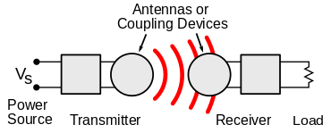
Technical Discussion
WPT is wireless point to point transmission protocol of electrical energy
Many implementations but Qi is the industry standard
Alternatives: AirFuel, Proprietary Near Field Magnetic Coupling, RF, Ultrasound
Delivers a variable amount of voltage to device depending on power requirements
New technology that lacks security capabilities and has vulnerabilities
Malicious messages can be sent between transmitter and receiver to alter power transmission
Messages between transmitter and receiver can be observed to gain information about receiver

Slide 4
Motivation
Wireless Power Transfer has become an industry standard being incorporated into more and more areas of technology
Personal Electronics, Healthcare Devices, Electric Vehicles
Exploit techniques and results found in this experiment can potentially be generalized
This research will create a foundation for further experimentation and TTP development
Findings expanded to other wireless non-networked point-to-point connections

Slide 5
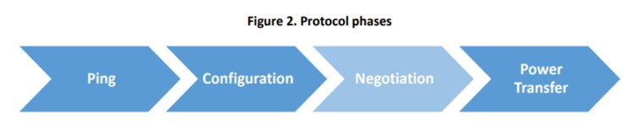
Qi Specs
AC frequency in the primary coil
110 and 205 kHz for the “low power” Qi chargers (up to 5 W)
80 and 300 kHz (up to 120 W) for the “medium power” chargers
Optimized to operate from a 5V USB power supply
Uses “smart power limiting” to adjust the output power automatically to compensate for power-limited supplies

Slide 6
Motivation
Wireless Power Transfer has become an industry standard being incorporated into more and more areas of technology
Personal Electronics, Healthcare Devices, Electric Vehicles
Exploit techniques and results found in this experiment can potentially be generalized
This research will create a foundation for further experimentation and TTP development
Findings expanded to other wireless non-networked point-to-point connections

Slide 7
Problem Statement
IDENTIFY
Vulnerabilities
How to exploit
How to defend
APPLY
Proof of concept – hijacking
Proof of concept – eavesdropping
Interpretation of results
EXPAND
Provide research to NRO
Observe various side channel-attacks
Create security mitigations – Software Based Encryption
Expand to larger technologies

Slide 8
Key Sprint Accomplishments
NRO Presentation
Signature Analysis
Signature Visualizations
.qid File Utilization
Qi Communication Research
Encryption Research

Slide 9


NRO Presentation
Developed two slide decks for NRO presentation (40 slides and 10 slides)
Successfully briefed the NRO representatives about key accomplishments and research

Slide 10
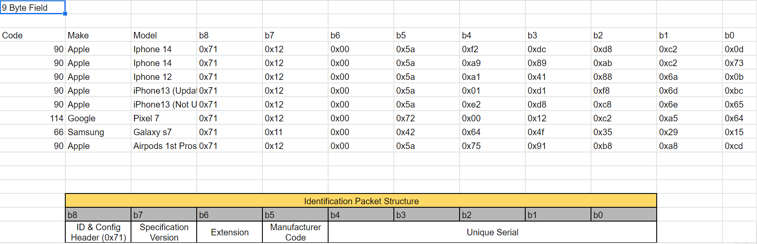
Fingerprinting
GUI deemed impractical given time constraints
Graphing capability added to analyze signatures

Slide 11
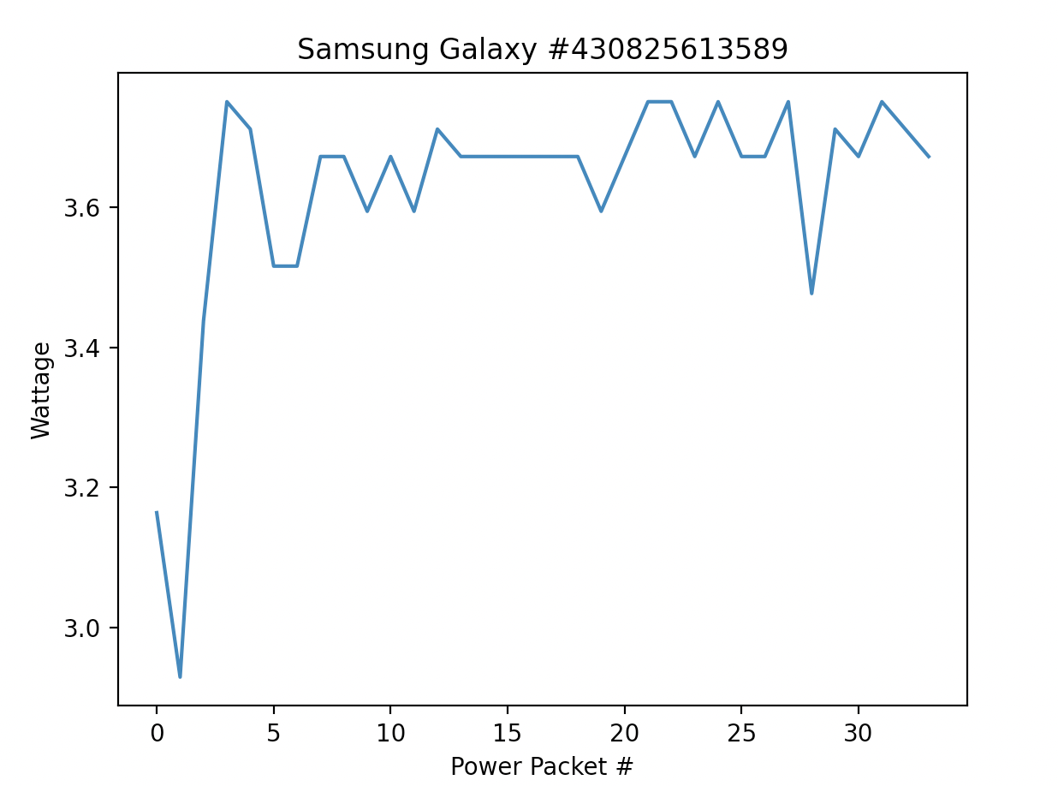
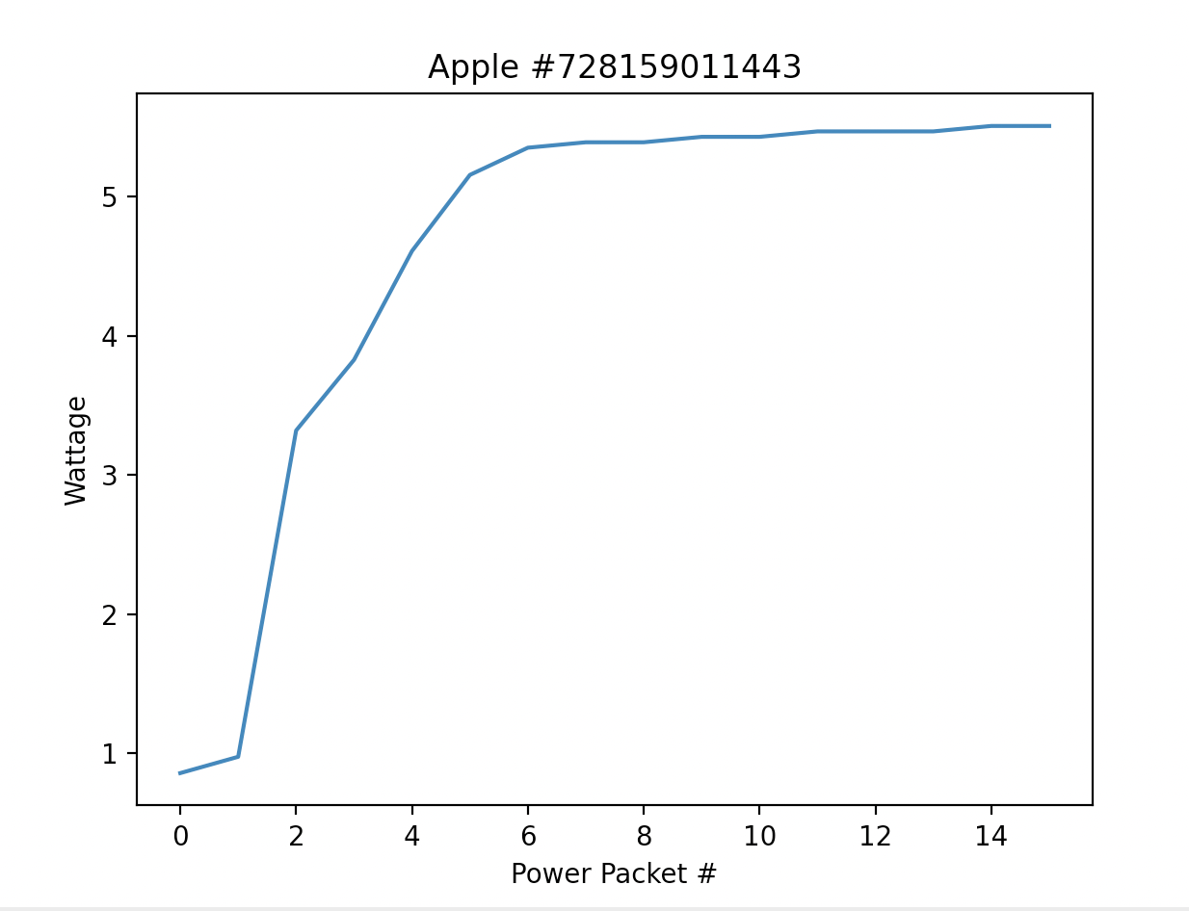
Signature Analysis
Signatures reinforce research
Working on more applications
Still inputting data by hand

Slide 12
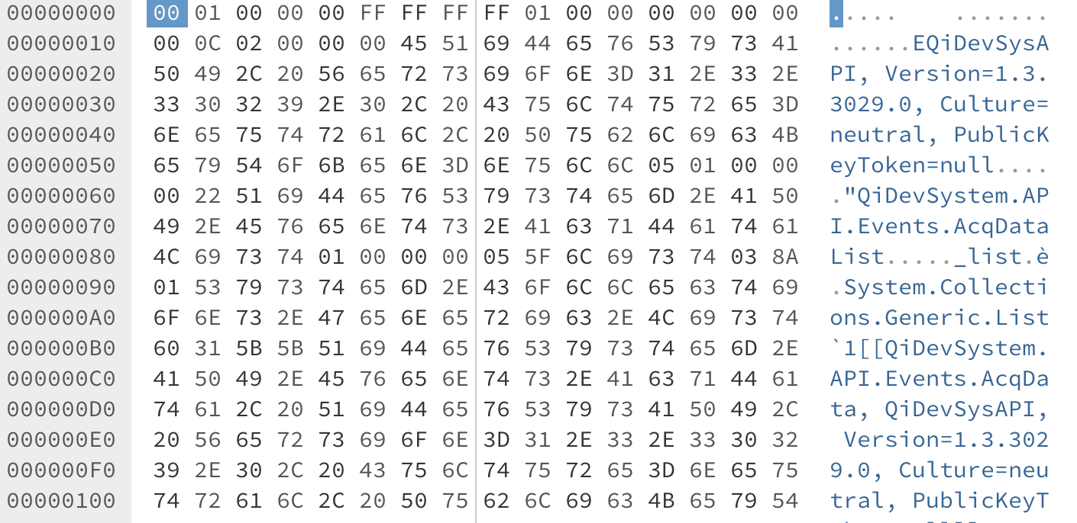
.qid Update
Hex file appears to contain metadata for sniffer software
Known packets could not be found with ctrl + f

Slide 13
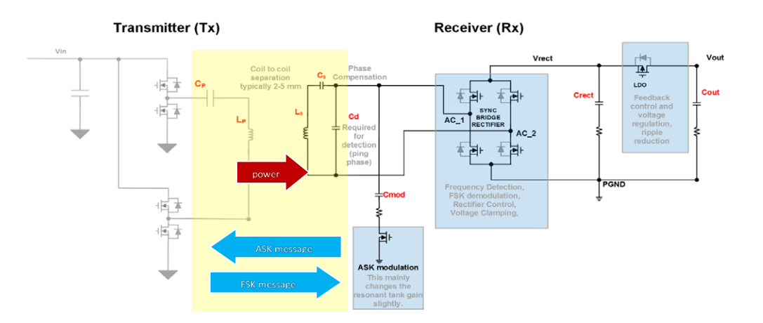
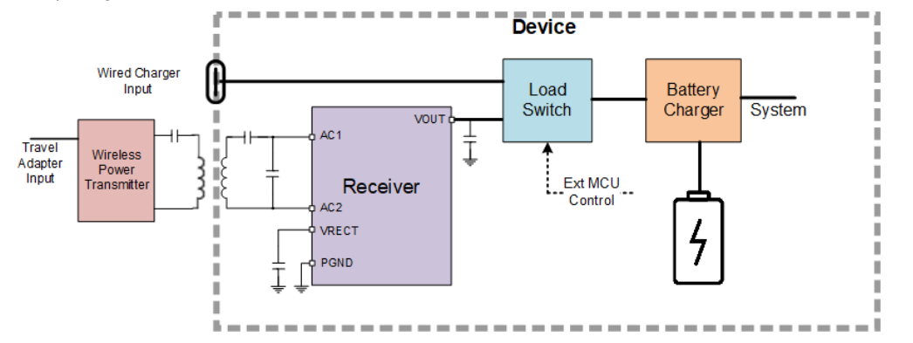
Qi Communication
The Rx monitors the battery and the charging process and uses ASK Modulation.
The Rx communicates at 2Kbs using a transistor array.
The Tx communicates at 200Bps using FSK modulation.

Slide 14
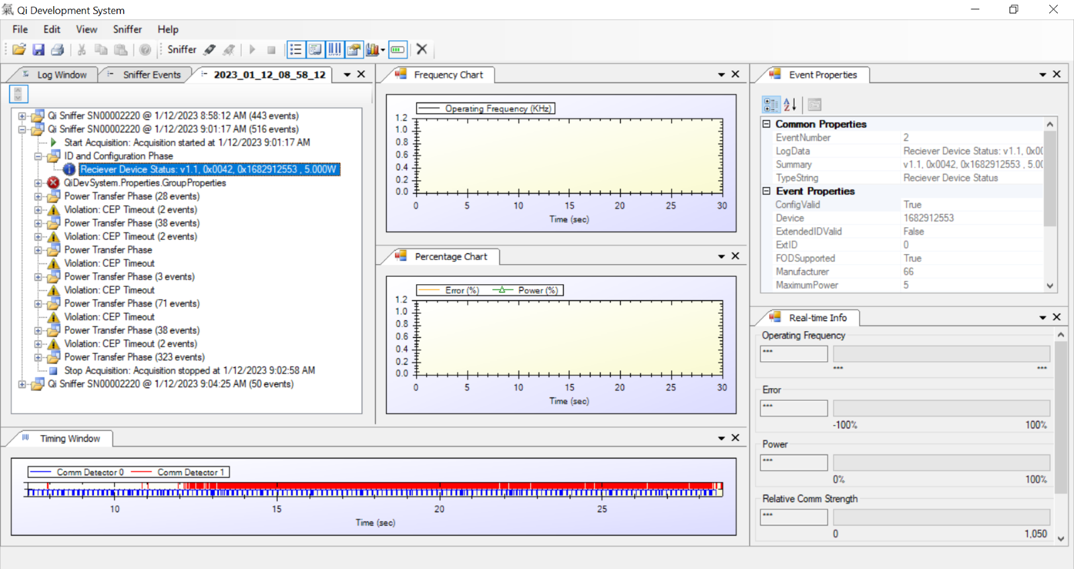
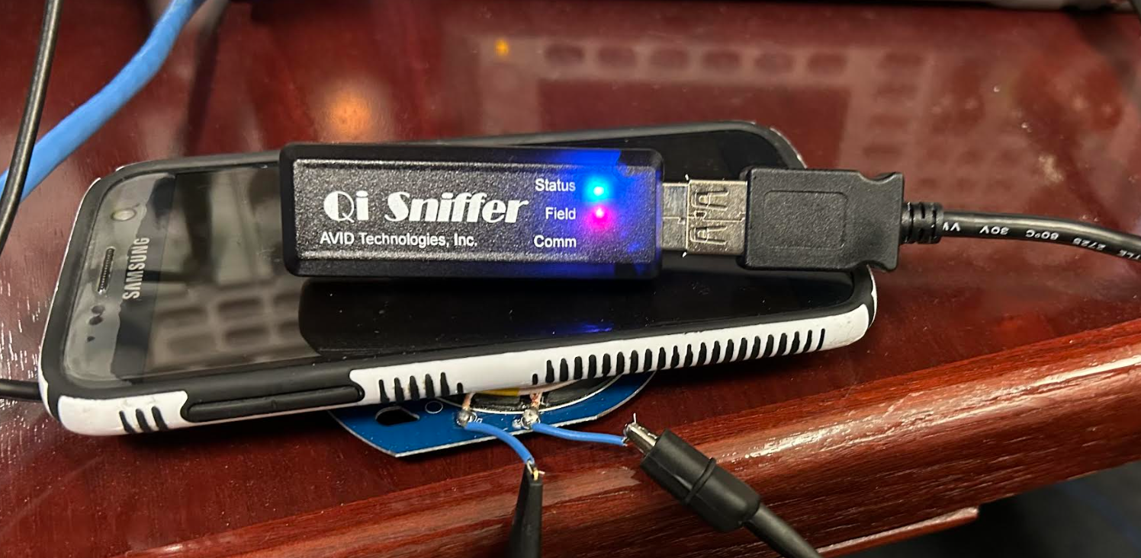
Qi Sniffer
Qi Development System
Communications insight
Seeking further interpretation of qid filetype

Slide 15
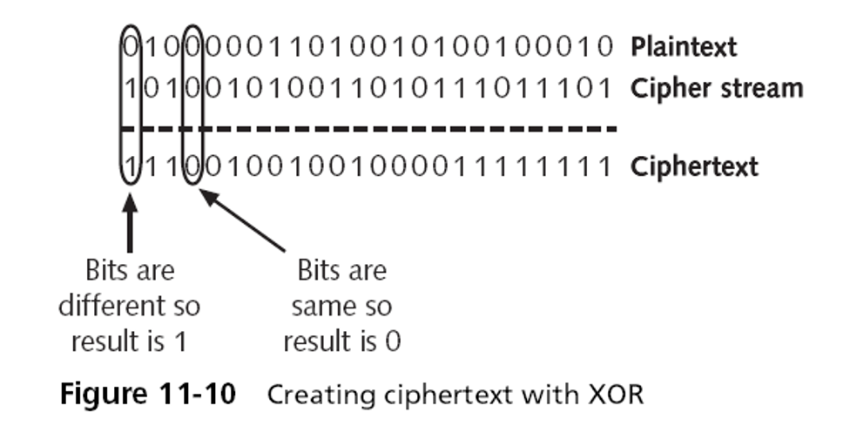
Linear Feedback Shift Register (LFSR) Encryption
LFSR is a stream cipher
Easily integrated into small devices
Basic level of encryption
Little to no effect on speed

Slide 16
Existing Challenges
ECE Injection Crafting
Qi Simulation layered with Encryption
.qid file parsing
Better tools than waveform generator for injection
Hardware knowledge

Slide 17
Discussion of Progress and Implications
Based on research and testing findings, Qi is an unsecure standard
It is susceptible to multiple attack vectors (based on proof of concept)
It is open air and thus susceptible to snooping (based on proof of concept)
There are some available methods to attempt to alleviate these vulnerabilities
Encryption (working towards proof of concept)
Other technologies/standards could be susceptible in the same ways
AirFuel, Proprietary Near Field Magnetic Coupling, RF, Ultrasound, EV Charging, Medical devices

Slide 18
Sprint 7 – Taskers/COA
Soft Encryption Development
Simulation representation expansion
Encryption timing validation and testing
LSFR, expand to further encryption schemes
(Packet Snooping and Injection mitigation)
Proceed with Fingerprinting
Expand visuals
Specific Emitter Identification
Constant Charge Transition (Charge/Don't Charge)
Waveform Generator Interface
Progress in OS DoS

Slide 19
Future Work
Modification of Qi packets
Qi communication packets are interpreted on the receiver device, modification of the data component within the Negotiation Phase may allow code execution or data exfiltration on the receiver device
Development and testing of Qi Protection Mechanisms
Hardware or Software based cryptography
Injection/packet modification detection
Applications with laser-based point-to-point communication
Non-networked systems

Slide 20
Questions?

